Slide 1
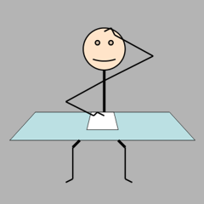
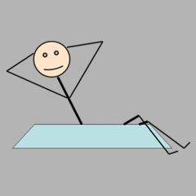
WORK
SHIRK

Slide 2
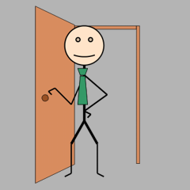
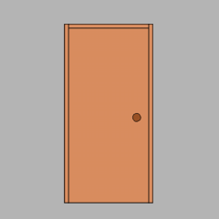
INSPECT
NOT INSPECT

Slide 3
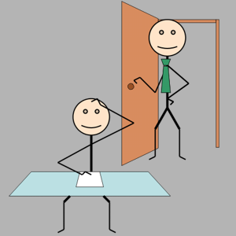
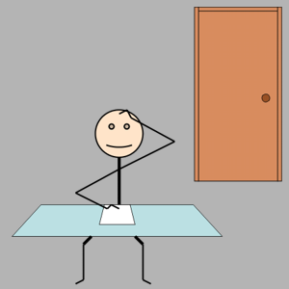
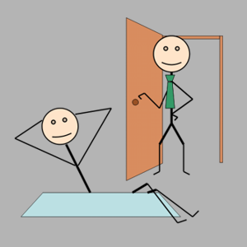
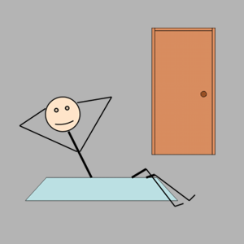
If you (the Employee) decide to work, and…
the Employer (Player 2)
inspects
the Employer (Player 2)
does not inspect
If you (the Employee) decide not to work, and…
the Employer (Player 2)
inspects
the Employer (Player 2)
does not inspect
The Employee wins: 50 points
The Employer wins: 0 points
The Employee wins: 0 points
The Employer wins: 100 points
The Employee wins: 0 points
The Employer wins: 25 points
The Employee wins: 50 points
The Employer wins: 0 points

Slide 4
If you (the Student) decide to work, and…
the Teacher (Player 2)
inspects
the Teacher (Player 2)
does not inspect
If you (the Student) decide not to work, and…
the Teacher (Player 2)
inspects
the Teacher (Player 2)
does not inspect
The Student wins: 50 points
The Teacher wins: 0 points
The Student wins: 0 points
The Teacher wins: 100 points
The Student wins: 0 points
The Teacher wins: 25 points
The Student wins: 50 points
The Teacher wins: 0 points

